Slide 1
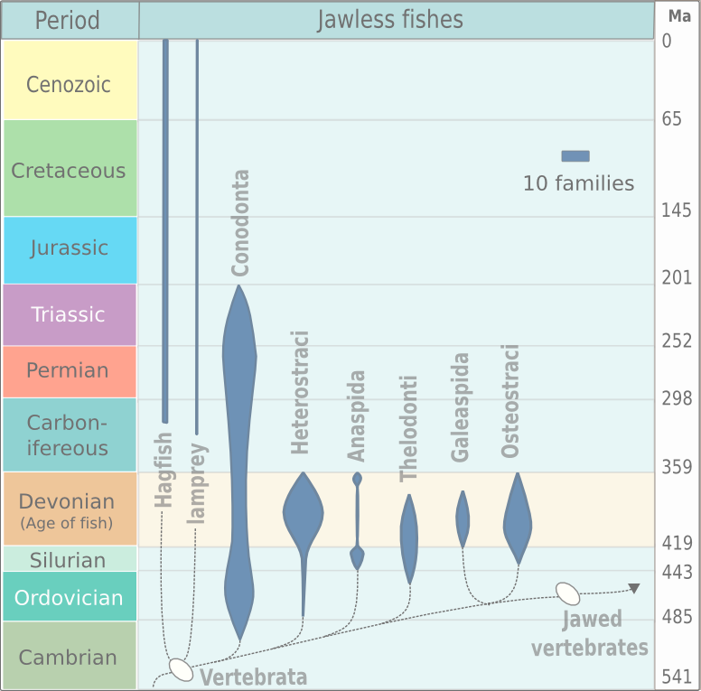
Paleozoic through Cenozoic
Cambrian
Ordovician
http://en.wikipedia.org/wiki/Agnatha
www.entangledbank.biz

Slide 2
Paleozoic through Cenozoic
Cambrian
Ordovician
www.entangledbank.biz

Slide 3
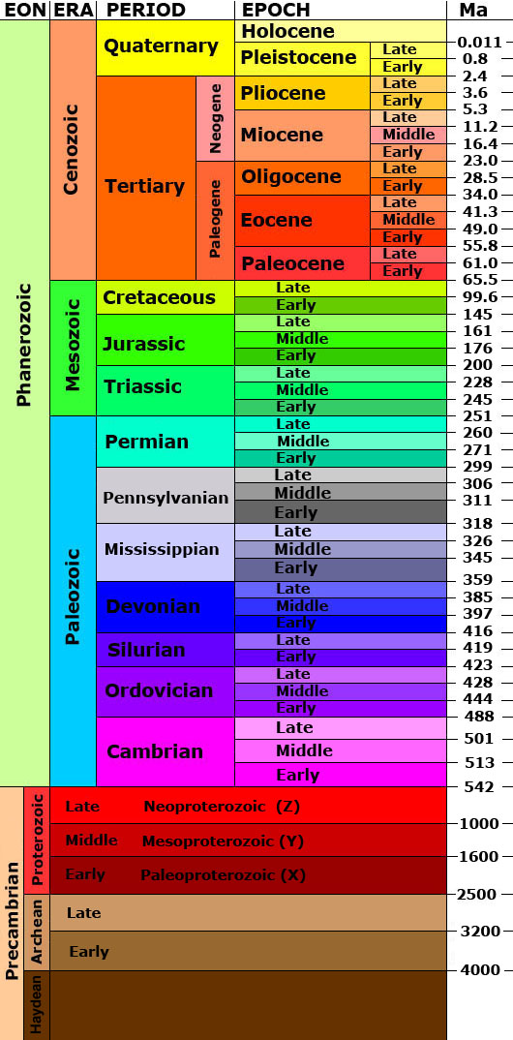
Paleozoic through Cenozoic
Cambrian
Ordovician
www.entangledbank.biz

Slide 4
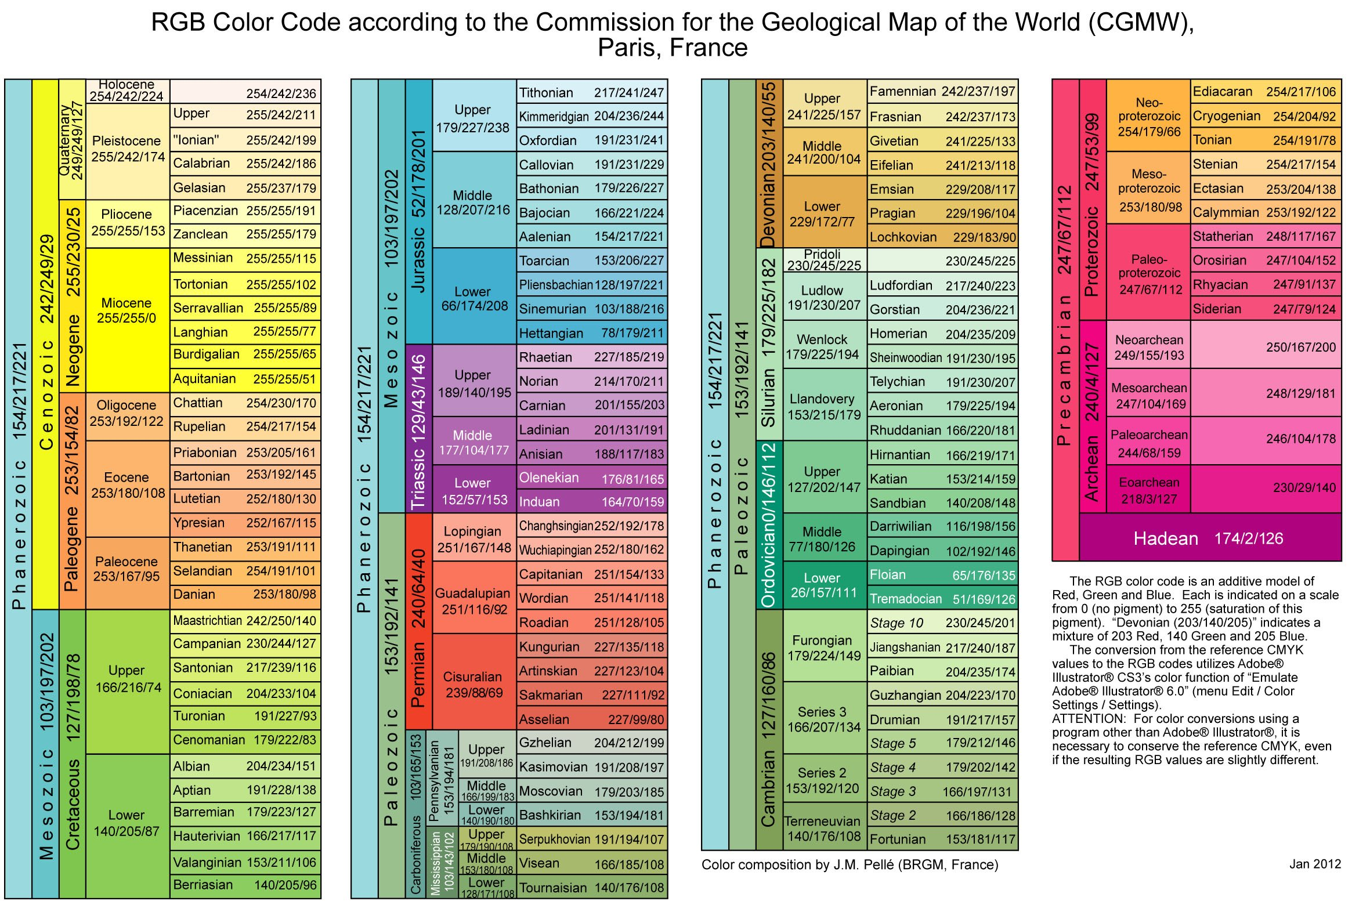
Paleozoic through Cenozoic
Cambrian
Ordovician
www.entangledbank.biz

